Slide 1

DESING AND SIMULATION SOFTWARE FOR RHODOTRON TYPE ELECTRON ACCELERATORS
BOĞAZİÇİ UNIVERSITY
Faculty of Arts and Sciences
Physics Department
Muhammet Furkan Er

Slide 2
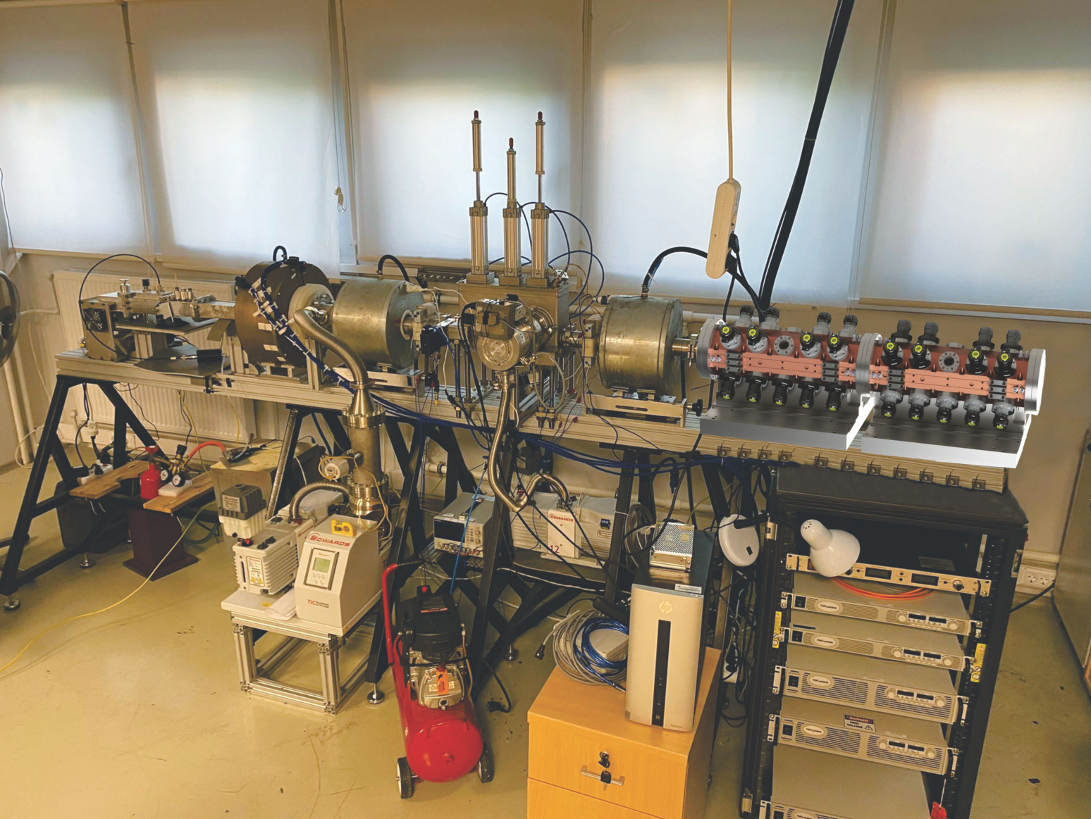
Particle Accelerators
Sophisticated scientific instruments designed to accelerate charged particles
Scientific research (GeV-TeV)
Discovery and characterization of fundamental particles and interactions
Industrial and medical applications (keV-MeV)
Medical particle accelerators
Sterilization of medical devices and food
Treatment of factory flue gases and wastewater
Wire, cable, and tire improvements

Slide 3
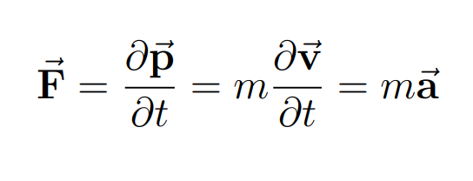
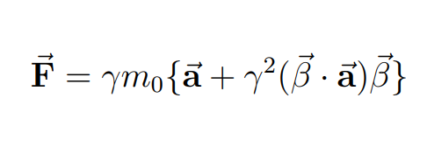
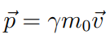
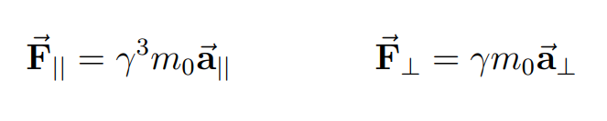
Theoretical Background
Acceleration & Force
Classical mechanics
Special Relativity
Force seperated to parallel and perpendicular directions with respect to v

Slide 4
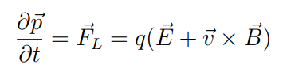
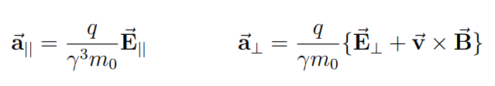
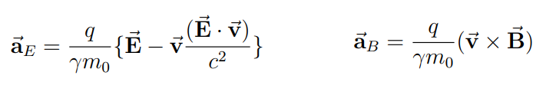
Lorentz Force
Force acting on a charged particle in electromagnetic fields.
q : charge of the particle
v : velocity of the particle
E : Electric field
B : Magnetic Field
Acceleration caused by Lorentz Force

Slide 5
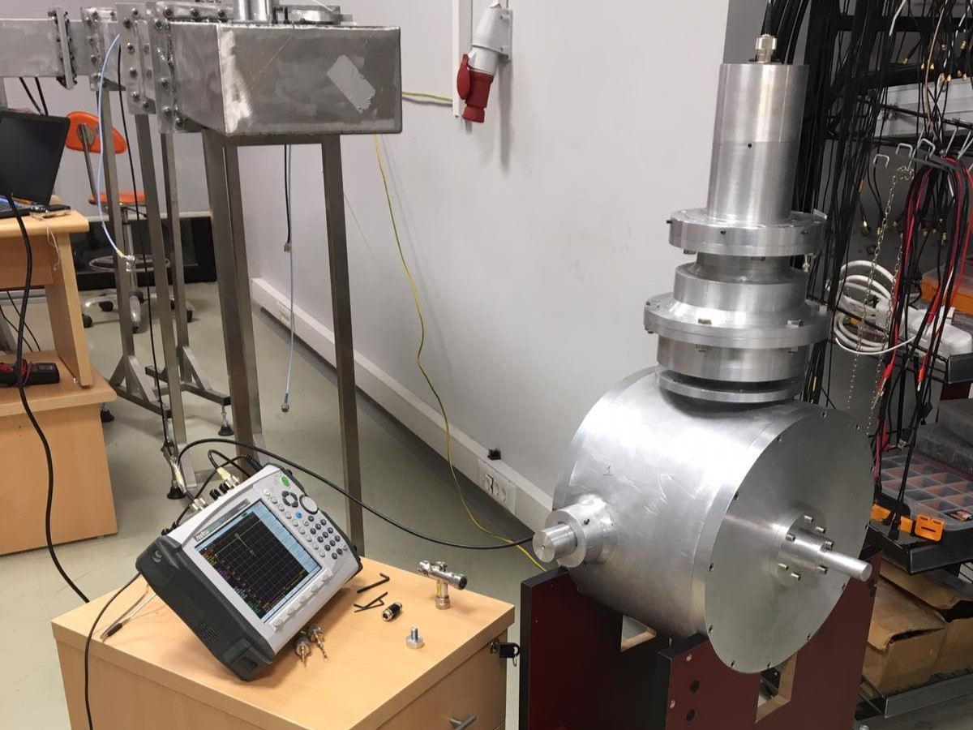
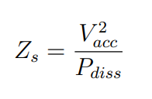
Accelerating Cavities
Designed to be resonant at specific frequency
Form standing Electromagnetic waves when driven by an RF power source at the resonance frequency
Accelerate incoming particles with proper synchronization to E & B fields (phase stability)
Shunt Impedance : Measure of the efficiency of acceleration with respect to power loss

Slide 6
Bending Magnets
Used in particle accelerators to control the trajectory of charged particles
They produce a magnetic field of specific strength, which can be controlled
Magnetic field exerts force on the particles travelling inside the magnet
This force causes the particle’s trajectory to curve, resulting in a bending effect

Slide 7
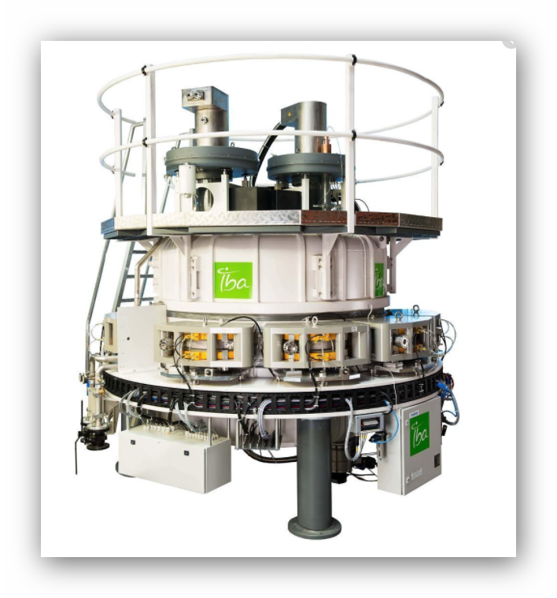
Rhodotron Accelerator
Proposed by Jacques Pottier in 1989
First prototypewas built at CEA Saclay in 1992
Ideal for MeV-level electron beams
Coaxial cylindrical RF cavity
Recirculating magnets

Slide 8
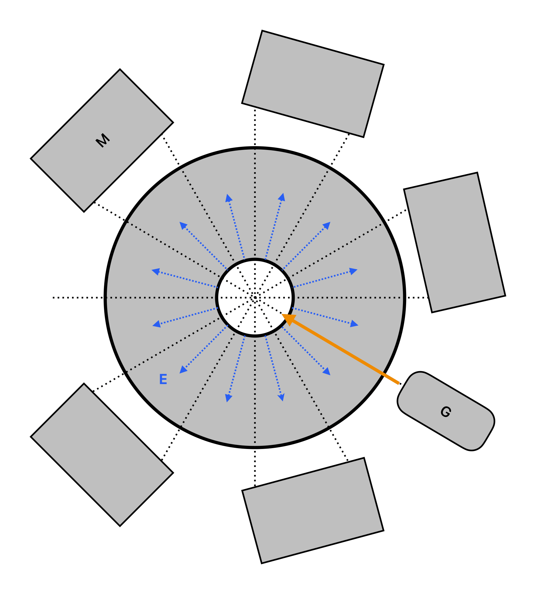
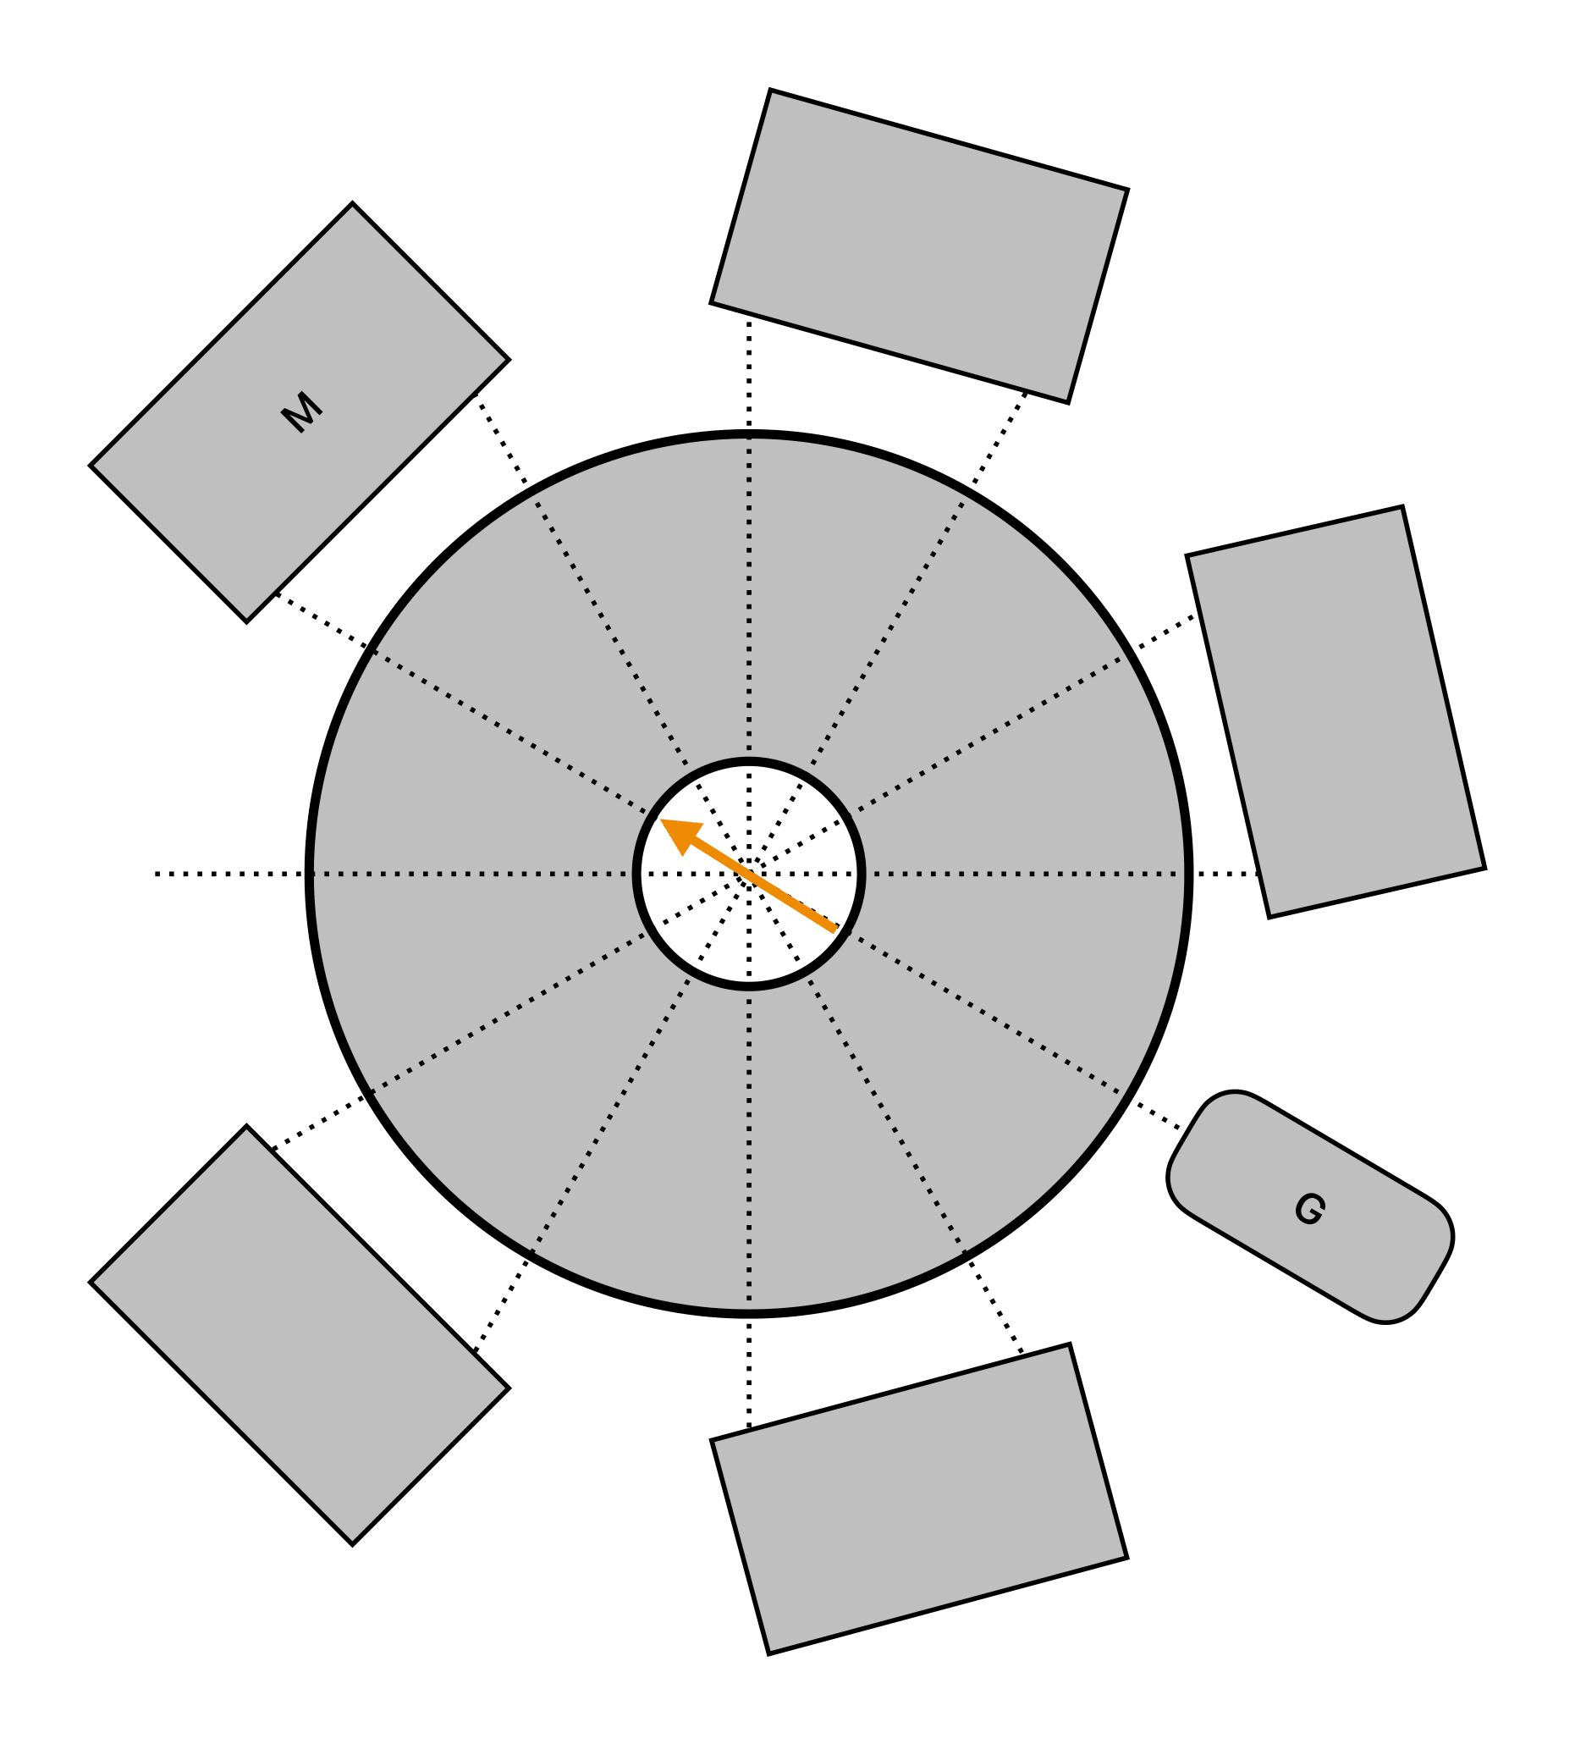
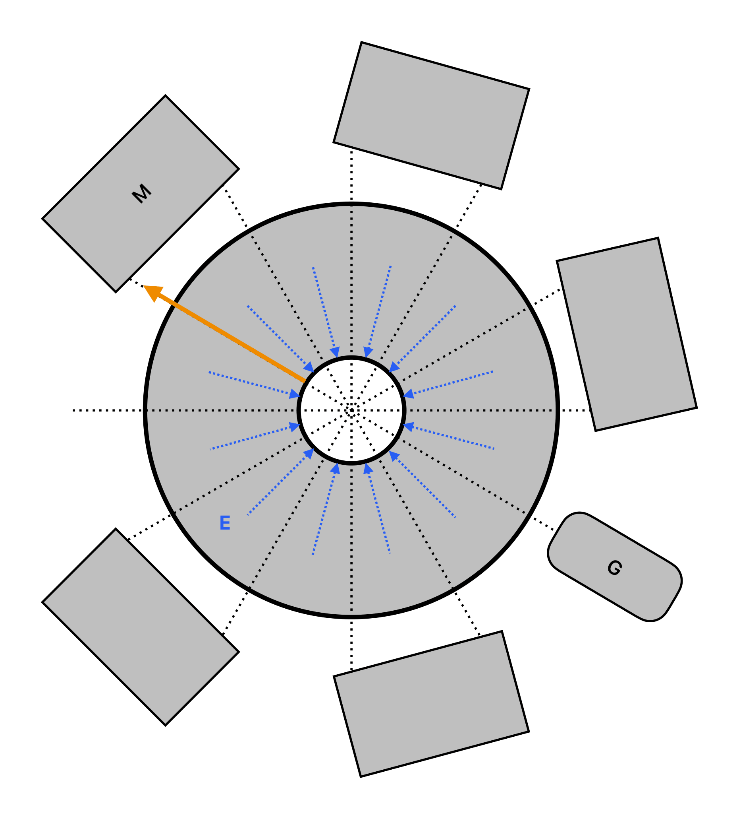
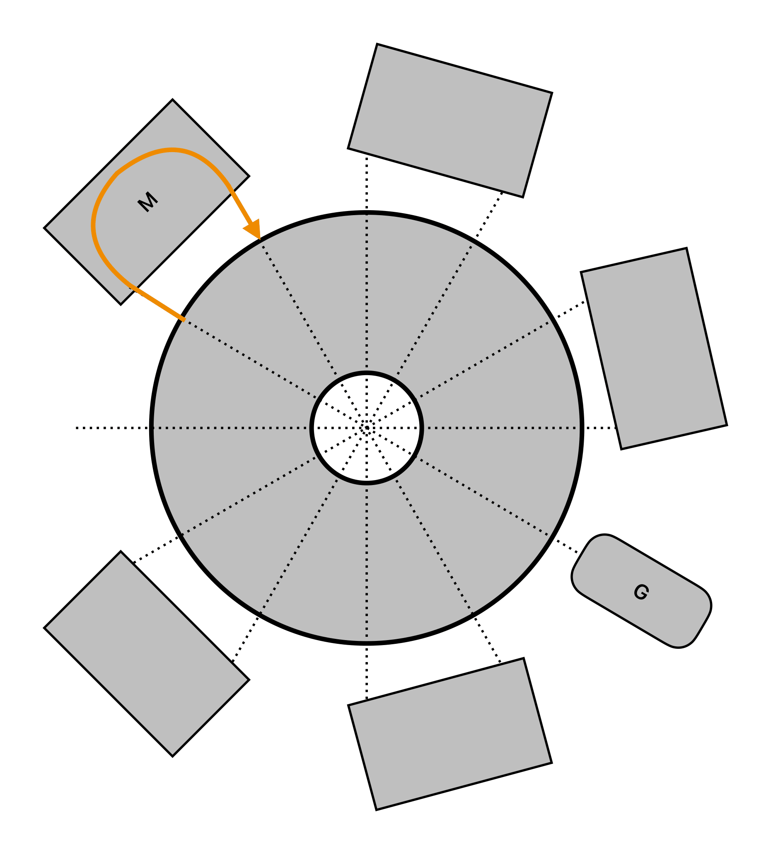
Acceleration cycle of a Rhodotron
First acceleration
Inner shielding
Second acceleration
Recirculating Magnets

Slide 9
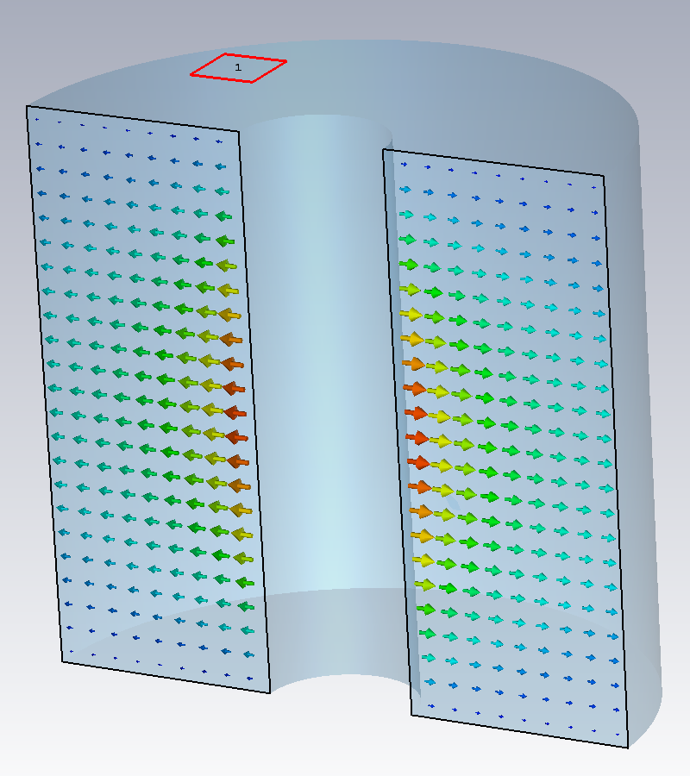
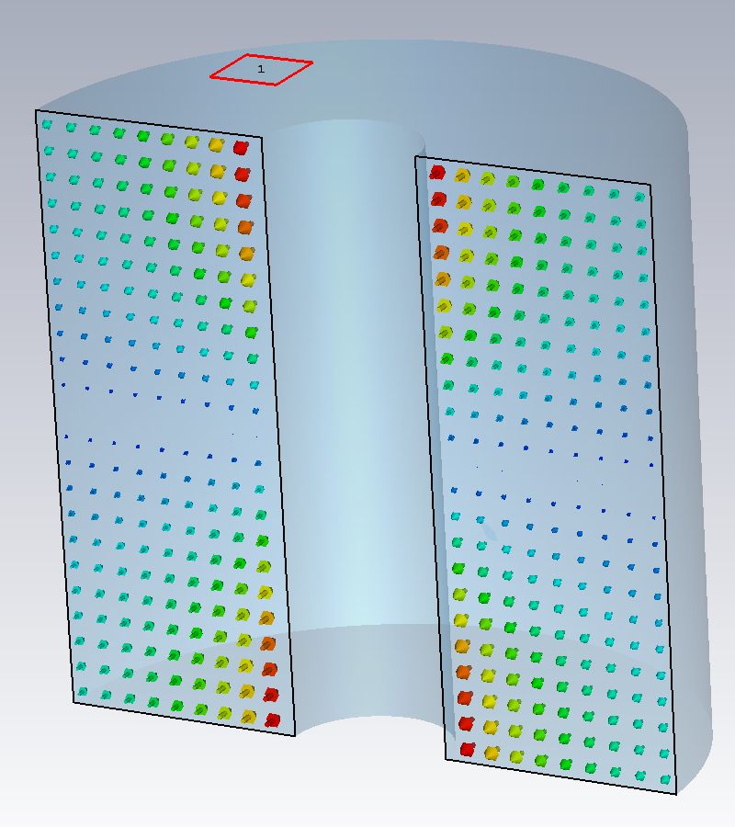
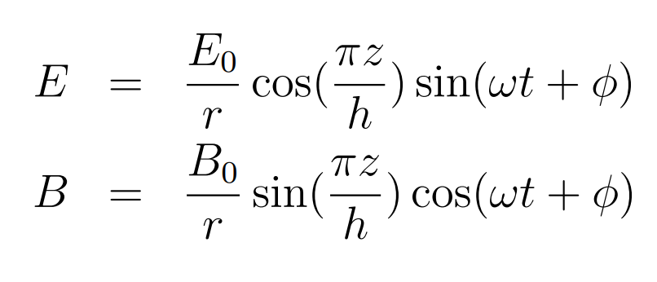
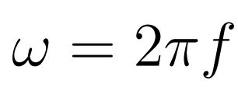
Cavity of a Rhodotron
Standing electromagnetic wave solution, first mode, in a simple coaxial cylinderical cavity operating at resonant frequency f
Electric field inside of a rhodotron cavity
Magnetic field inside of a rhodotron cavity

Slide 10
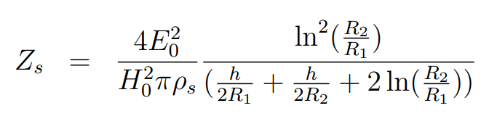
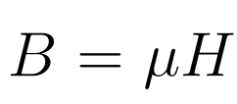
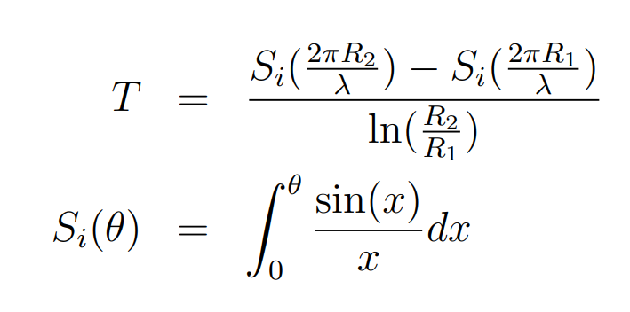
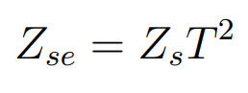
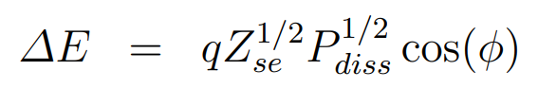
Acceleration in Rhodotron Cavity
Shunt Impedance of a simple
coaxial cylindirical cavity (Zs)
R1 : radius of the inner cylinder
R2 : radius of the outer cylinder
h : height of the cavity
ρs : skin resistivity
μ : permeability
Time transit factor (T)
λ : wavelength of the E & B fields
Effective Shunt Impedance (Zse)
Energy gain (ΔE) of a relativistic particle crossing r=0 at φ=2π*f*t
Pdiss : Power dissipated on the cavity walls

Slide 11
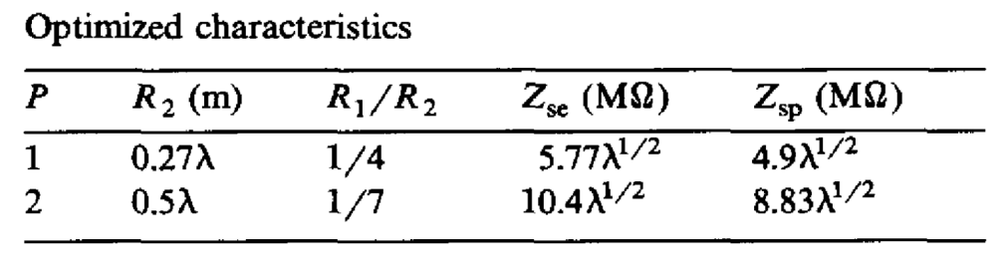
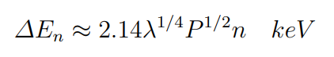
Energy Gain Calculations by Pottier
Optimized characteristics by Jacques Pottier
Zsp : practical effective shunt impedance, taken as 0.85Zse
Energy gain after n successive acceleration cycles (ΔEn) calculated by Pottier.
λ : wavelength of the E & B fields in meters
P : Power dissipated on the cavity walls in watts

Slide 12
Available Tools
Poisson Superfish
A software solution for design and analysis of electromagnetic fields
Helps optimizing behavior of charged particles and the electromagnetic structures such as cavities and magnets
Developed by the Los Alamos National Laboratory
Commonly used in the field of accelerator physics
CST Studio Suite
Electromagnetic simulation and analysis software
Simulates behavior of electromagnetic fields and their interactions with different materials, structures and charged particles
Developed by Simulia
Widely used in various industries, including electronics, aerospace, accelerator physics.
ROOT
Data analysis, visualization, and storage framework
Developed by CERN
Essential tool in particle physics, used by physicsts around the world
Gnuplot
Software package for creation of data plots and graphs
Developed by Thomas Williams and Colin Kelley
Widely utilized in scientific research and data analysis

Slide 13
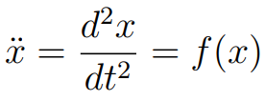
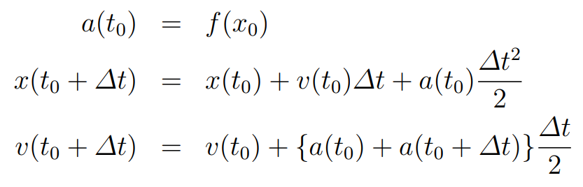
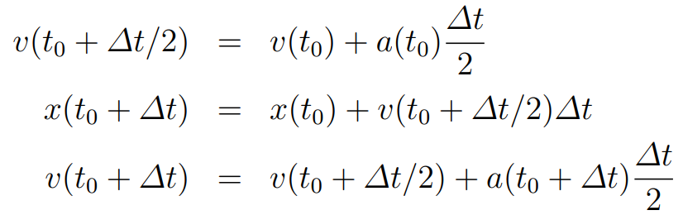
Numerical Methods
Leapfrog
A numerical method commonly used to solve ordinary differential equations (ODEs) that involve second-order time derivatives.
Most used version
Kick-drift-kick version

Slide 14
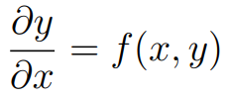
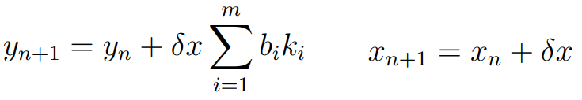
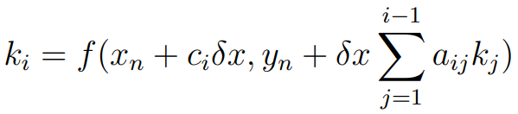
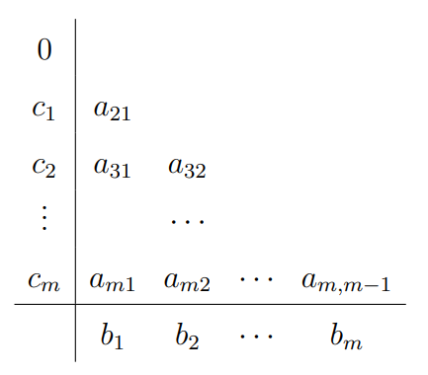
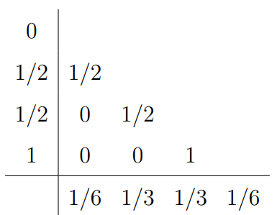
Numerical Methods
Runge Kutta
Family of numerical methods used to solve ordinary differential equations (ODEs) that are in the following form
The family of methods are defined by the following equalities:
A method can be specified by the order m and the coefficients aij, bi, ci
Coefficients aij, bi, ci can be visualized by a tableau called Butcher Tableau
The most commonly used Runge Kutta method is the forth-order, known as RK4.

Slide 15
Designing a Rhodotron
Cavity Design Flow Chart
Determine frequency f (λ)
Select p from optimized characteristics table of Pottier
Simple cavity is achieved.
(R1, R2, h)
Round the edges to decrease power loss (improve Z)
Truncate the inner cylinder to improve Z
Use simulation tools to verify resonance frequency

Slide 16
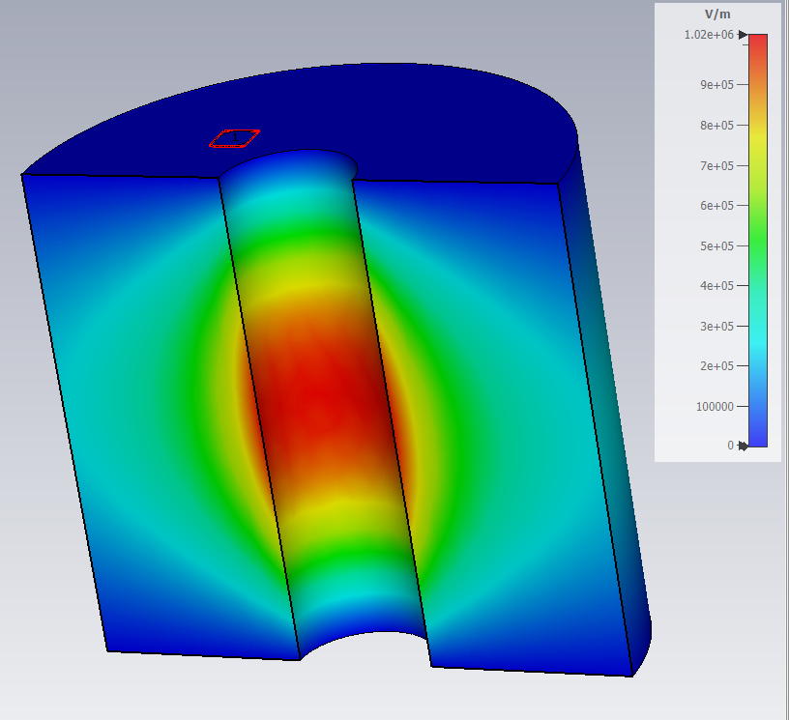
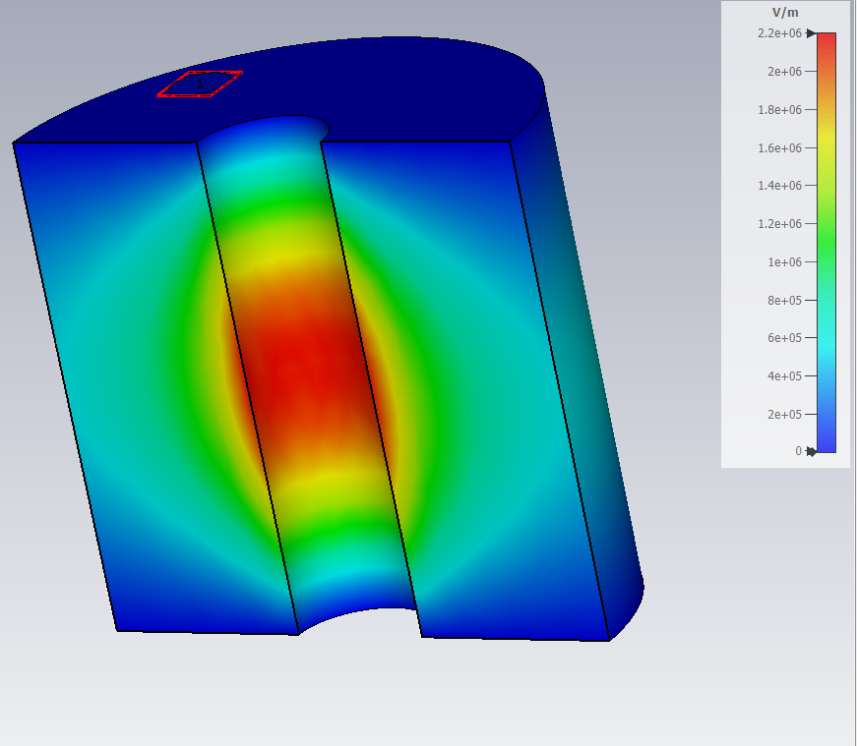
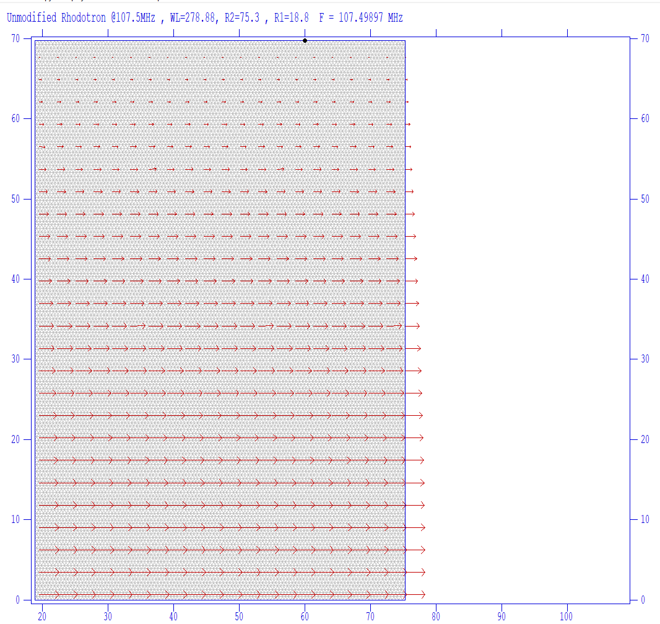
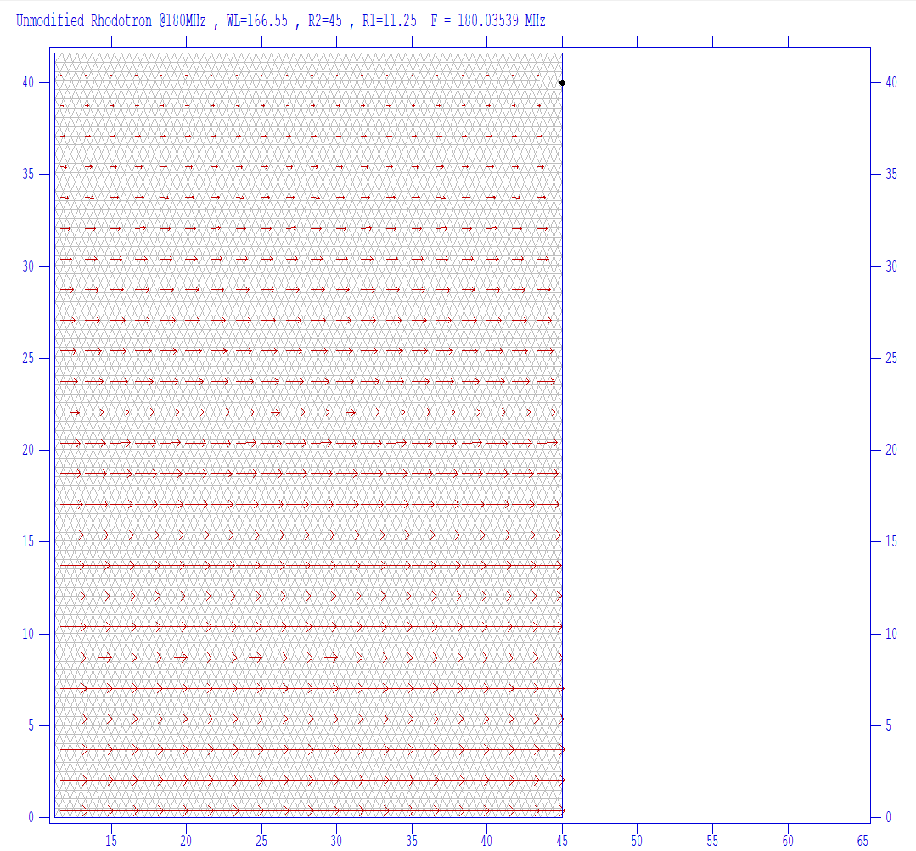
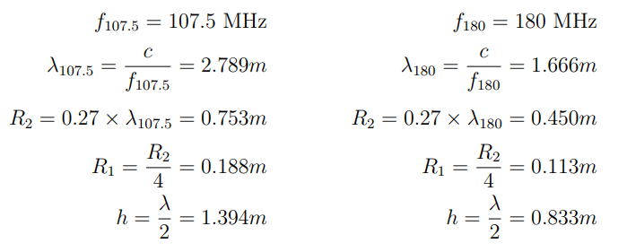
Designing a Rhodotron
Simple Coaxial Cavity Calculations
f = 107.5 MHz
f = 180 MHz

Slide 17
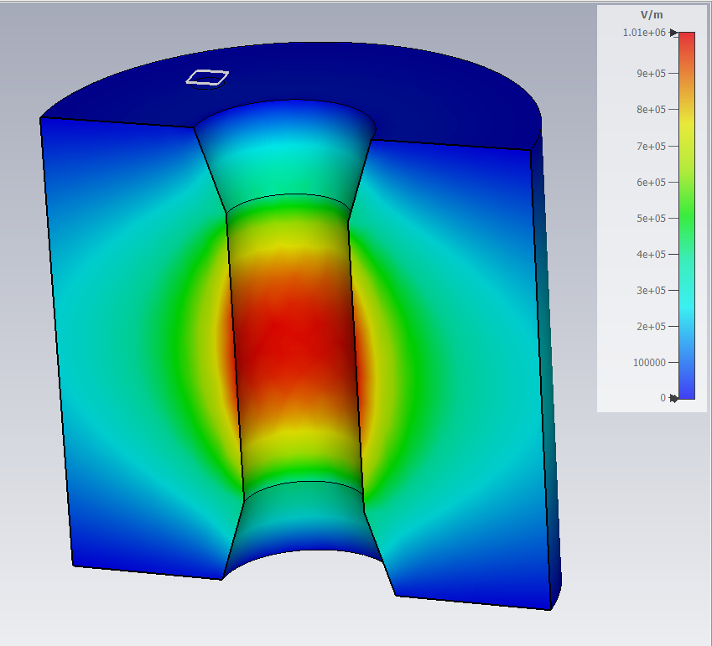
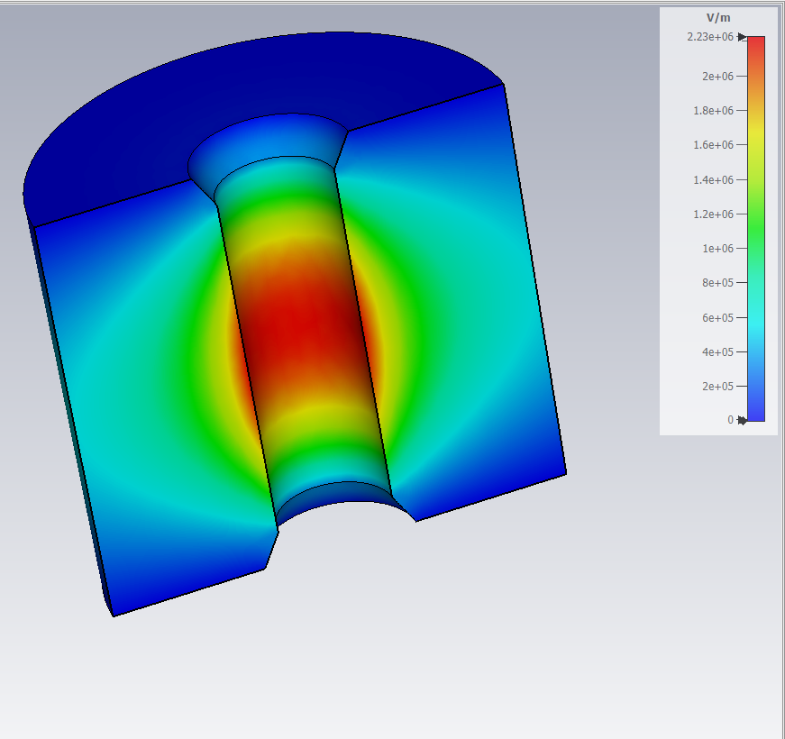
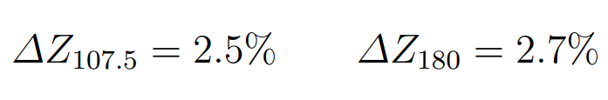
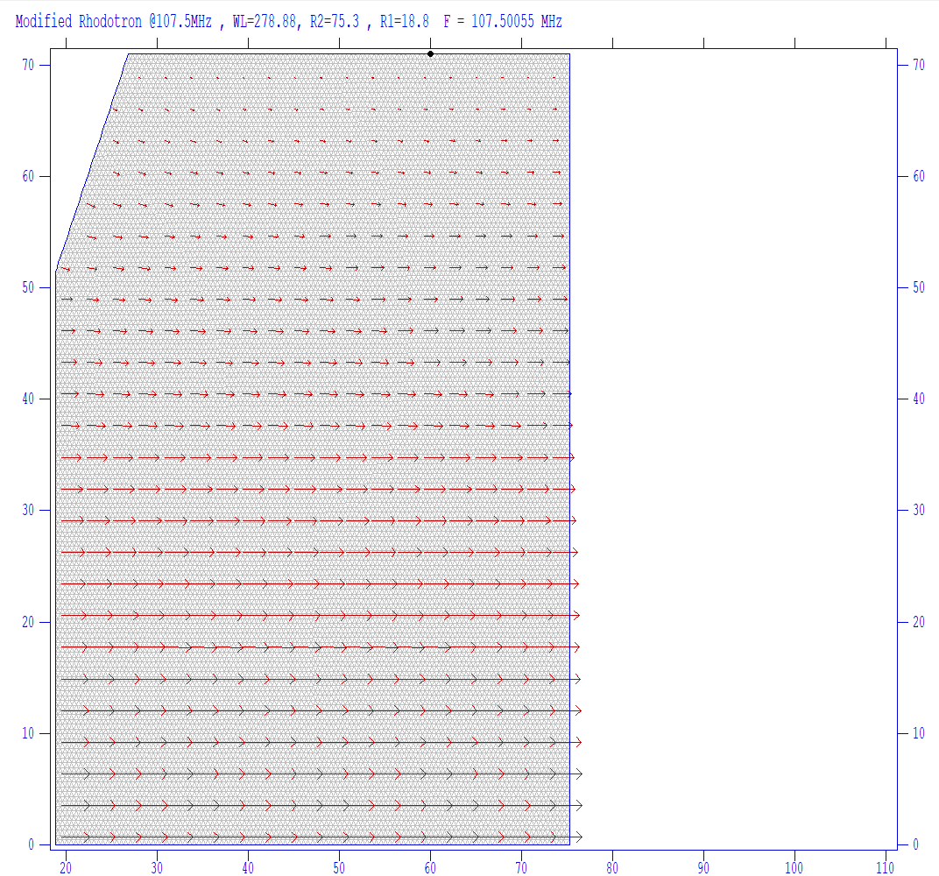
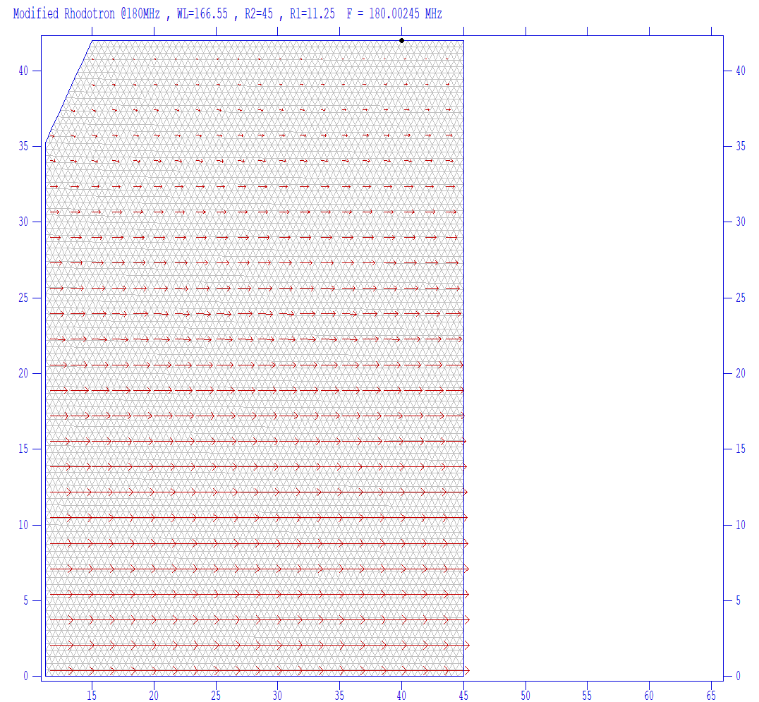
Designing a Rhodotron
Truncated Cavity
Recommended by Pottier
f = 107.5 MHz
f = 180 MHz

Slide 18
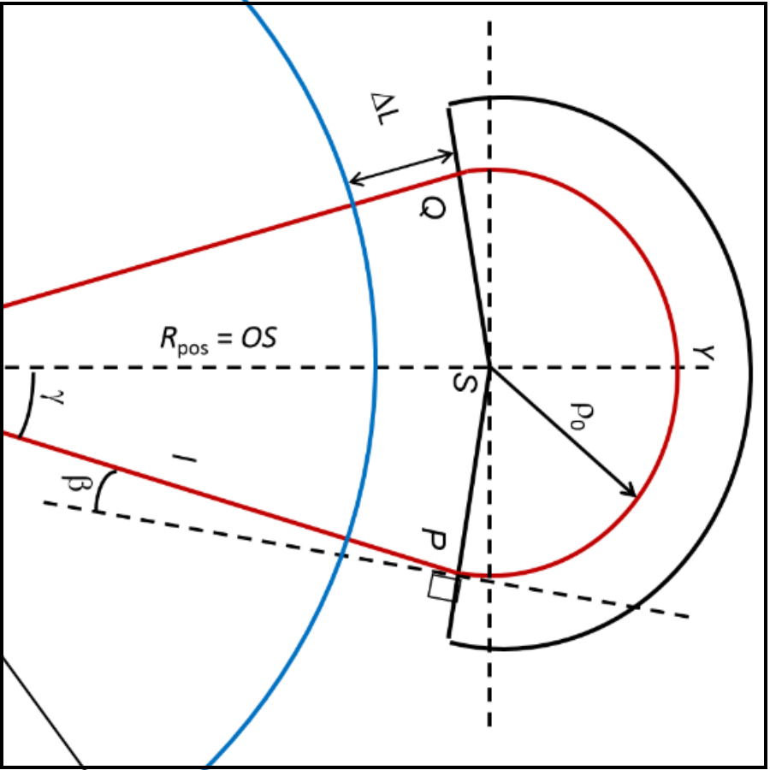
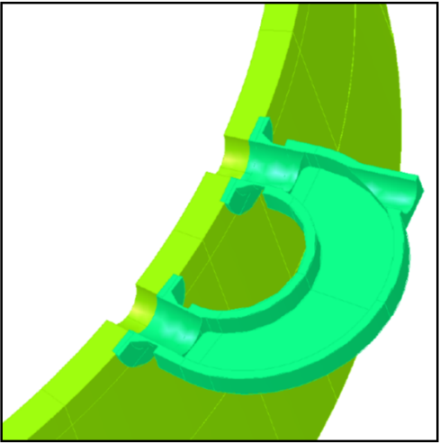
Designing a Rhodotron
Magnet Design
Magnets are used for not only guiding the electron beam to desired path, but also for synchronizing them with the RF field in the cavity. Time spent outside of the RF cavity should be precisely tuned to maximize acceleration in the succeeding pass

Slide 19
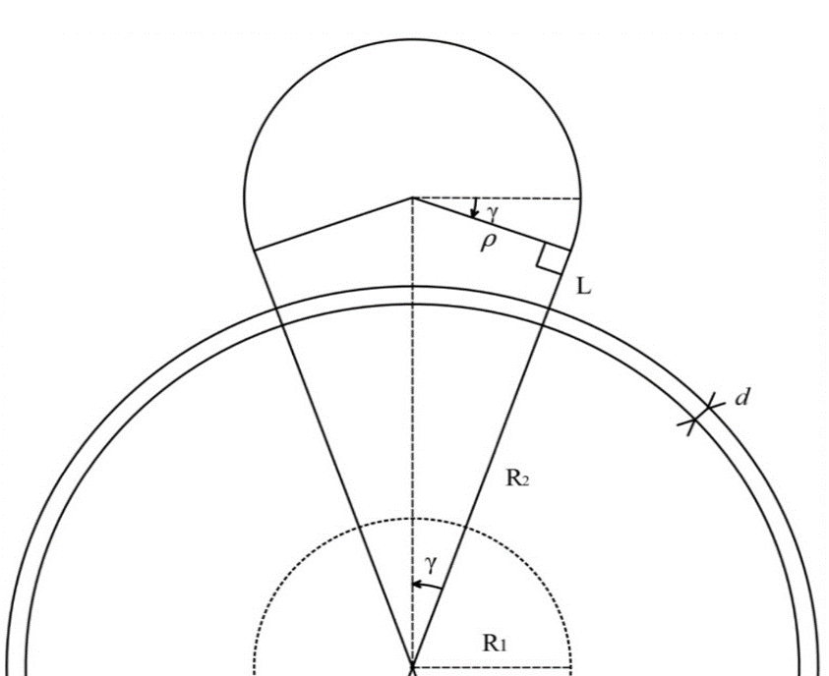
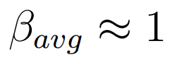
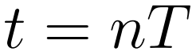
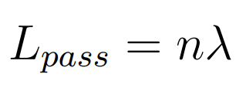

Designing a Rhodotron
nλ Technique for Magnet Design
Assumption : v ≈ c
n > 1 is inefficient, taking n = 1:

Slide 20

Designing a Rhodotron
Lout Parameter Sweep for Magnet Design
What if v << c ?
Instead of Lpass=nλ, sweep for different Lout value.
For example, f = 1 GHz, P = 50 kW, ϕ = 15◦
Define an optimization criteria such as
Maximize energy gain
Ensure phase stability
Use a simulation software to sweep Lout, find optimum value
Calculate ρ and L of the magnet
A custom built software offering magnet optimizing sweep functionality will be discussed in the following chapter.
βavg too low to design for β=1

Slide 21



Designing a Rhodotron
Initial Design at KAHVELab
A rhodotron with operation frequency of 107.5 MHz was planned to be built at KAHVELab

Slide 22




Designing a Rhodotron
CST Simulations of Initial Design
Ein = 40 keV
RF power = 12 kW
Phase lag = 15◦
Gun active time = 1 ns
The behavior of the beam in the multi pass simulation indicates that phase stability is not maintained.

Slide 23



Designing a Rhodotron
Further Improvements of the design
Cavity edges have been rounded to reduce power loss on cavity walls
Magnet design improved to reduce iron volume and magnetic field leak

Slide 24


Rhodotron Simulation
Proof of Concept
After considering the lack of design and simulation software available for Rhodotron-type accelerators, the need for a custom built tool became apparent. A simple 1D proof of concept was implemented for this purpose.
It worked with interacting an electron with the EM field provided, at discrete time steps dt.

Slide 25

Rhodotron Simulation
Proof of Concept
POC software and CST produced very similar results
POC was found to be promising
Decision was made to develop a more robust simulation software, Rhodotron Simulation

Slide 26

Rhodotron Simulation
Lout Optimization For Single e−
First step of Rhodotron Simulation
Hangs the e − outside of the cavity for tout = Lout/v
Injects back with reversed v
Sweeps for tout to find the optimal value
Found to be promising after comparing the simulation results with CST
Needs to consider bunches to be useful in magnet design

Slide 27

Rhodotron Simulation
ϕlag Optimization For Bunches
Added bunch mechanism (N electrons injected at even time intervals, total injection time : tg, period of injections : Tg)
ϕlag : RF phase when the first e− of the bunch has entered the cavity
Initial implementation sweeps for ϕlag parameter by injecting bunches at varying ϕlag values
Minimizes Erms
<E> would be maximized by manually analyzing the data
After the addition of bunches, Lout Optimization was also updated to minimize Erms

Slide 28



Rhodotron Simulation
Example ϕlag & Lout Optimization Run
P = 12kW
f = 107.5 MHz
R1 = 0.188 m
R2 = 0.753 m
tg = 1 ns
Ein = 40 keV

Slide 29

Rhodotron Simulation
Simulation in 3D
Up to now, only e-E interactions are simulated
To simulate e-B interactions simulations needs to be in 3D
Required complete refactoring
Rhodotron Simulation was redesigned to use OOP
For the current stage, magnets were modeled as major segments of a circle defined with
r : position of the center of magnet
R : radius of the magnet
B : magnetic field inside the magnet (assumed to be uniform with no leaks)
e-EM interaction logic in 3D

Slide 30


Rhodotron Simulation
Visualization
Gnuplot was integrated into Rhodotron Simulation to produce 2D visualization of acceleration plane.
P = 12kW
f = 107.5 MHz
T = 9.3 ns
R1 = 0.188 m
R2 = 0.753 m
tg = 1 ns
Ein = 40 keV
Tg = 9.3 ns
Tg = 5 ns

Slide 31

Rhodotron Simulation
Acceleration in Magnetic Field
Energy gains during e-B interactions were observed
An investigation was started for the causes and possible solutions problem
A test setup was implemented
100 electrons at 1 MeV
Uniform magnetic field ( B = 0.1 T ) located at x > 0.05 m
Initial test with dt = 0.01 ns showed 2.783 MeV of energy gain inside B
Until this point, Leapfrog was used because of its simplicity.
RK4 was also integrated to test if the problem was originating from Leapfrog

Slide 32


Rhodotron Simulation
Acceleration in Magnetic Field
Implementation of RK4 in e-EM interaction

Slide 33


Rhodotron Simulation
Acceleration in Magnetic Field
Both Leapfrog and RK4 was tested with variety of dt values.
Each setup was run 10 times to reduce the effect of OS scheduler related randomness
Tests were done on Apple M1 CPU

Slide 34




Rhodotron Simulation
Acceleration in Magnetic Field
A performance measurement F has been defined
Two F values has been calculated for each method:
F(dt = 1*E-05 ns)
F(ΔELF = ERK)
After combining,
Leap-frog was found to be the better choice as it provided with 1.36 ± 0.05 times accuracy efficiency in e-B interactions at a given time with respect to RK4
Leapfrog data
RK4 data

Slide 35


Rhodotron Simulation
Acceleration in Electric Field
After e-B interactions, it was decided to test e-E interaction as well.
Two test setups were implemented
100 electrons at 1 MeV were injected at (−0.753, 0, 0) m in both setup
Setup 1 :
E = (−2.65616, 0, 0) MV/m at −0.753 < x < 0.753 and −0.753 < y < 0.753
E = 0 elsewhere
Setup 2 :
E = (0, −5.31232, 0) MV/m at −0.753 < x < 0.753 and −0.753 < y < 0.753
E = 0 elsewhere

Slide 36




Rhodotron Simulation
Acceleration in Electric Field
Setup 1
Setup 2

Slide 37


Rhodotron Simulation
Acceleration in Electric Field
Both Leapfrog and RK4 was tested with variety of dt values.
Each setup was run 10 times to reduce the effect of OS scheduler related randomness
Tests were done on Apple M1 CPU
Results from Setup 2

Slide 38




Rhodotron Simulation
Acceleration in Electric Field
Two F values has been calculated for each method in Setup 1 :
F(dt = 1*E-05 ns)
F(ΔELF = ERK)
Setup 1 Leapfrog data
Setup 1 RK4 data

Slide 39



Rhodotron Simulation
Acceleration in Electric Field
Two F values has been calculated for each method in Setup 2 :
F(dt = 1*E-05 ns)
F(ΔELF = ERK)
After combining all 4,
Therefore, it can be concluded that Leapfrog outperforms RK4 with the relative performance of 2.11 ± 0.03 in e− E interactions with static uniform E field.
Setup 2 Leapfrog data
Setup 2 RK4 data

Slide 40

Rhodotron Simulation
Multithreading
Multithreading implementation efforts were ongoing since the start of the project
Latest approach had a main thread that manages other threads, a UI-Console notifier thread, and worker threads
Different architectures for worker threads have been implemented and tried
Have a thread pool that calculates e−EM in a queue
Assign a thread to each bunch
Assign random electrons to each thread and calculate e−EM with global time
Assign random electrons to each thread and calculate e−EM with local thread time

Slide 41
Rhodotron Simulation
Multithreading
Architecture 1 would require constant waiting in worker threads to get mutexes of E field, especially in RK4
Architecture 2 was not increasing performance in lower bunch count configurations as expected
Architecture 3 was inefficient and wasteful since all the worker threads would wait the main thread to get the next time after they finish calculation, while the main thread would be waiting for the slowest worker thread.
Architecture 4 was thought to be the best performer. It would give freedom to calculate the whole simulation to each thread while giving up the global time. This would also mean thread-safety is ensured since there is no shared data between the worker threads. However, this architecture can cause issues if e−e interactions were decided to be implemented in the future
Another caveat is that a copy operation of E⃗ and B⃗ objects for each worker thread would be needed. This would lead to larger memory allocations and more time spent setting up simulations. Therefore, Architecture 4 is not ideal for fast calculations and when the memory is an important constraint. An implementation that can use both Architecture 2 & Architecture 4 when necessary, would be a better approach considering these methods; nevertheless, Architecture 4 was chosen to be implemented

Slide 42

Rhodotron Simulation
Graphical User Interface
Rhodotron Simulation could be used with a configuration file
Simple and fast; however, it was not suitable for the average user
A GUI was decided to be built, using ROOT framework
Can also use of analysis tools offered by ROOT
An example config.in file

Slide 43

Rhodotron Simulation
Graphical User Interface
Rhodotron Simulation, now called simulation engine was updated to be able to run as a background service
The GUI would be a standalone application, running the simulation engine when needed
User can use simulation engine directly as before
GUI consists of several main frames, each having a seperate responsibility
Configuration
Simulation
Render
Analyze
Sweep
Illustriation of the first GUI design

Slide 44

Rhodotron Simulation
Graphical User Interface
Configuration Frame
Provides an interface for specifying, saving or loading a configuration
Consists of different configuration regions
B field
Cavity
RF
e-gun
Simulation
Configuration Frame of the GUI

Slide 45

Rhodotron Simulation
Graphical User Interface
Simulation Frame
Spawns and manages the simulation engine
Configures and starts the simulation
Shows the current progress of the simulation, communicating with UI handler thread in simulation engine
Simulation Frame of the GUI

Slide 46

Rhodotron Simulation
Graphical User Interface
Render Frame
Renders the last simulation
Can watch a playback or render a specific time frame
Can export animations or snapshots
3D rendering is work in progress
Render Frame of the GUI

Slide 47

Rhodotron Simulation
Graphical User Interface
Analyze Frame
Provides tools for analyzing and visualizing the simulation data
In the current version, has two analysis tools
Electron energy distribution histogram
E(t) graph of each electron
Can export graphs
More tools are work in progress
Analyze Frame of the GUI, Energy Distribution

Slide 48



Rhodotron Simulation
Graphical User Interface
Why does phase stability matter?
Synchronous electron
~optimal phase lag
Unsynchronous electron
Suboptimal phase lag
Unsynchronous electron
Non optimal phase lag

Slide 49

Rhodotron Simulation
Graphical User Interface
Sweep Frame
Implements parameter sweep
In the current version, it only has phase lag sweep
Can visualize sweep data
Can export graphs
More parameters to be swept are work in progress ( Lout sweep etc. )
Sweep Frame of the GUI, showing φ vs <E>

Slide 50


Rhodotron Simulation
Graphical User Interface
Sweep Frame of the GUI, showing φ vs σE
Sweep Frame of the GUI, showing φ vs σR

Slide 51

Production
Production efforts of a Rhodotron-type accelerator are still ongoing in KAHVELab
Key design parameters of this accelerator:
f : 107.5 MHz
P : 50-100 kW
Ein : 40 keV
Etarget : 1-5 MeV

Slide 52


Production
Rendered Visuals of The Final Design

Slide 53

Production
Rendered Visuals of The Final Design

Slide 54
Production
Technical Drawing of the Cavity

Slide 55
Production
Manufacturing
Manufacturing of the cavity has been ongoing, planned to be completed in the following weeks
The cavity was manufactured as 5 main parts, using 5mm thick 304L stainless steel sheet.
Sheets were then pressed to achieve the shapes of the parts
Inside surfaces of these sheets were polished with 2000 grits
304 stainless steel sheet bars of different sizes were welded on the outside surface of the cavity for pressure resistance
Several flanges were then machined:
4.5in EIA RF flange for RF input
ISO-100KF vacuum connector flanges for vacuum pumps
ISO-63 KF flange for probe insertion
KF-40 flanges for beam line and vacuum gauges
Because the main body of the cavity was 5mm thick and 304L was used, deformations on cylindrical symmetry were encountered.
This problem was solved by welding 10mm thick toroidal sheets between the coaxial cylinders
These sheets was removed after the heat treatment

Slide 56


Production
Manufacturing
Polishing of a pressed sheet, upper part of the cavity
Toroidal sheets were added between the parts

Slide 57


Production
Manufacturing
Welding of the sheet bars
KF40 flanges on the beamline

Slide 58

Production
Current state of the cavity
The cavity has been assembled
Vacuum tests have been completed
Getting ready to measure the resonance frequency

Slide 59
Conclusion
Production efforts of a new rhodotron type electron accelerator are currently continuing in KAHVELab.
Present bottleneck is the fabrication of the cavity
Cavity production is in the concluding stages. It has been assembled and vacuum tests have been completed. The resonance frequency is being measured.
Recirculating magnet production was kept on hold due to the disagreement on the energy gain amount between the calculations and simulations.
Rhodotron Simulation is ready to be tested with the cavity. Several improvements and new feature implementations are underway in the meantime:
E and B field import
Sychrotron radiation calculations
e-e interactions
3D rendering
Performance improvements on e-EM interactions
Faster rendering
Extention of analysis tools
Integration of Lout sweep in GUI
After the manifacturing of the cavity, energy gain predictions of Rhodotron Simulation will be tested. Complementary recirculating magnet design will be the first challenge of Rhodotron Simulation, which will provide tremendous testing and improvement opportunities.

Slide 60
Discussion
Rhodotron Simulation, a new computational e−EM interaction simulation and analysis tool that focuses on designing and improving Rhodotron-type accelerators has been successfully developed.
A Rhodotron-type accelerator with an operating frequency of 107.5 MHz and a target energy of 1 − 5 MeV has been designed and is currently being manufactured.
The software features a robust GUI that is capable of rendering and analyzing simulation results
Leapfrog and Runge-Kutta numerical methods have been implemented for initial speed and accuracy tests
The real-world performance and accuracy of this new tool could not be tested before the cavity production is completed and the performance is compared with the predictions of the tool
However, the capabilities Rhodotron Simulation presents, coupled with the analogous results obtained from other extensively utilized simulation tools, lead to the conclusion that it holds promise.

